Slide 1




BATCH 19 MINOR PROJECT
POTHOLE DETECTION USING YOLO
GUIDED BY,
Mr.M.G.RAJENDRAKUMAR.

Slide 2
TEAM MEMBERS
MAHENDRAVARMAN R S [927621BEC111]
MALLESH S [927621BEC112]
SANTHOSH P [927621BEC311]
MANIKANDAN S G [927621BEC307]

Slide 3
ABSTRACT
Potholes pose a significant threat to road safety and infrastructure maintenance worldwide.
This paper presents a novel approach for the automated detection of potholes in road surfaces utilizing the YOLO (You Only Look Once) object detection framework.
Our methodology involves training a YOLO-based deep neural network on a large dataset of road images and annotating pothole locations.

Slide 4
INTRODUCTION
In this cutting-edge application of YOLO (You Only Look Once) object detection technology, we unveil a powerful solution for automating the identification and assessment of road potholes.
Our system promises real-time, accurate detection, and localization of potholes, revolutionizing road maintenance and safety.

Slide 5
Methodology
Dataset Creation: We will create a diverse and extensive dataset of road images, meticulously annotated to mark the precise locations of potholes.
YOLO Integration: We will modify and fine-tune the YOLO architecture to detect potholes effectively.
Real-time Detection: Our approach enables real-time pothole detection, which is essential for timely response by authorities and road maintenance teams.
Application Potential: The proposed pothole detection system can be integrated into existing traffic management systems, navigation apps, or autonomous vehicles to enhance road safety and infrastructure maintenance.

Slide 6
Software Components Used
LabelImg Library.
Opencv Library.
Anaconda Prompt.
Google Colab notebook.

Slide 7
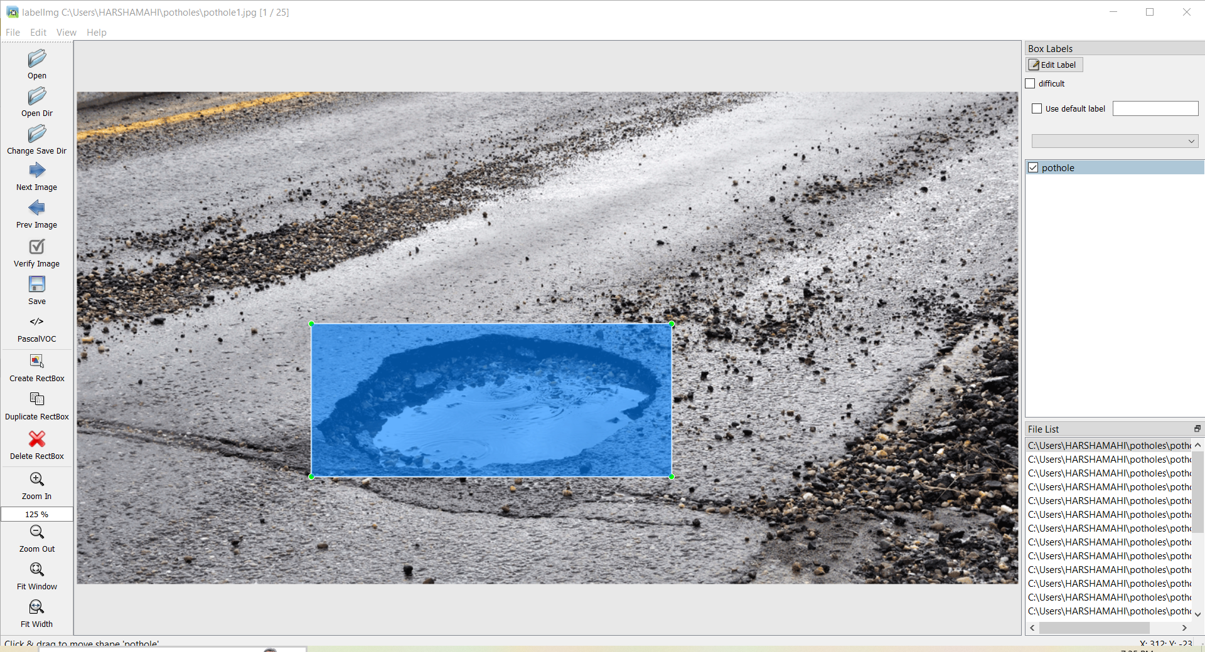
Labelling the Pothole using LabelImg

Slide 8
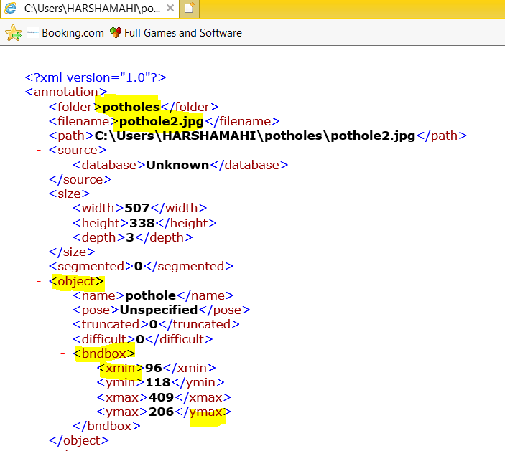
Viewing the .XML file Created by LabelImg
Here we can See the .xml file created by the labelImg annotator.
First it shows the File location of the Photo, after that the size of the photo along with the width.
Then the Bounding Box which is the annotated thing and marking it as pothole.
This is the way of creating the dataset.

Slide 9
Future work
Dataset Expansion.
Real-time Processing.
Anomaly Detection.
Deployment and Integration.

Slide 10
Thank you

